Slide 1
Project and Error Management Application
PRESENTATION for SUPPORT OF THE dissertation WORK
Scientific coordinator: Conf. Univ. Dr. Coșulschi Mirel
Graduate: Georgescu Ion-Eduard

Slide 2
Project and Error Management Application
The dissertation “Project and Error Management Application” presents the development of the Atlas application which is a web application that allows the management of the projects, errors, requests and tasks, that are designed to be used for organizations, groups of users, and students.
This dissertation highlights the development of the application using the tools offered by ASP .NET Core and the component management benefits offered by the Angular platform.

Slide 3

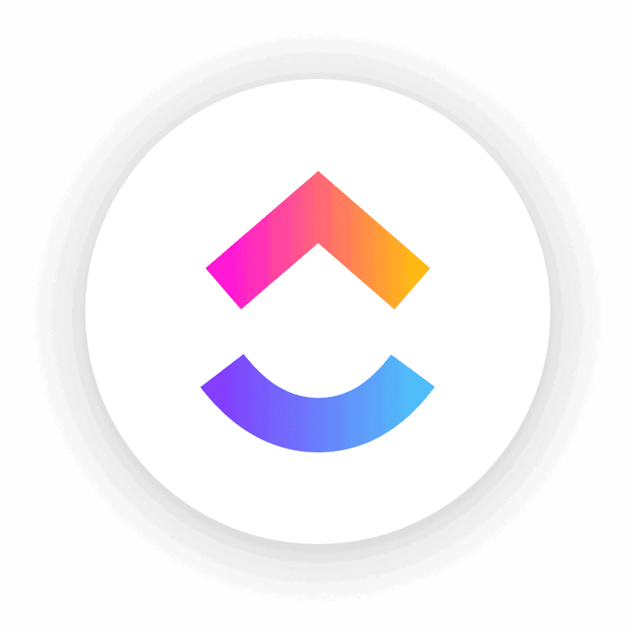


Project and Error Management Application
Similar Applications: Jira, ClickUp, Basecamp, Shortcut
The idea of developing the Atlas application has originated from the personal curiosity for the implementation methods used for developing the Jira application and it’s features.
Jira is part of a family of products designed to help teams of all types manage work. Originally, Jira was designed as a bug and issue tracker. But today, Jira has evolved into a powerful work management tool for all kinds of use cases, from requirements and test case management to agile software development.
Although the Atlas application is missing several features that other application are already offering, Atlas fully resembles a simpler version for work management applications like these.

Slide 4
Project and Error Management Application
What are the features that Atlas application is offering?
Secured authentication method using JWT
Creation, reading, update and delete features for submitted issues and projects
Possibility to add comments to the submitted issues
Activity tracker for the submitted issues
Version tracker and restore points for the submitted issues
Account management options for logged users
Pagination options and searching for the submitted issues

Slide 5

Project and Error Management Application
What tools and features have been used to develop the client interface for Atlas?
Angular is the main platform used to develop the client interface and the features used during development are the following :
Components – used for linking templates with services
Models – used for requests and data preparation
Templates – used to display html code and data
Services – used to share methods between components
Resolvers – used to retrieve data from the API server
CSS – used for customizing the html elements

Slide 6

Project and Error Management Application
What tools and features have been used to develop the REST services for Atlas?
ASP .NET Core is the main platform used to develop the REST services and the features used during development are the following :
Controllers – used for processing the requests
Models – used for responses and data preparation
EntityPackage – used to generate custom authentication database tables
Migrations – used to create and update the database
SQL Server – the database server used to store data

Slide 7
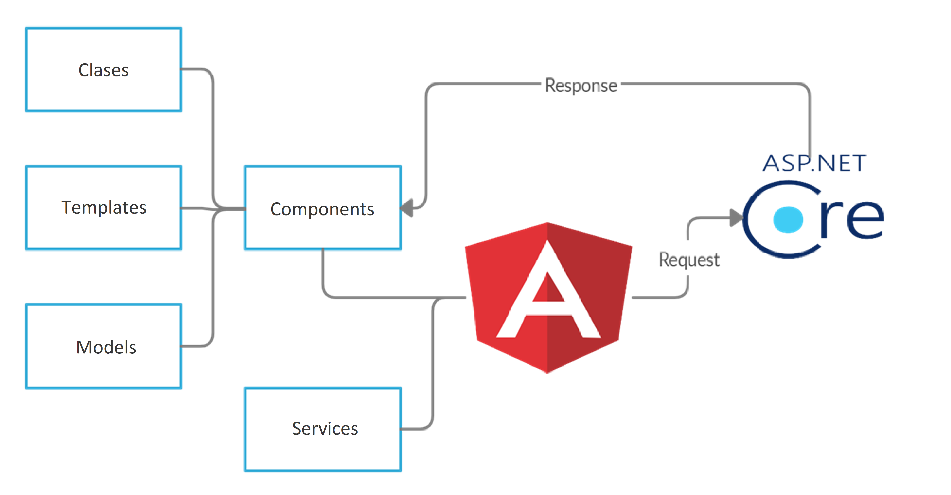
Project and Error Management Application

Slide 8
Project and Error Management Application
For a performance point of view, the application has been developed and can be hosted using two separate servers, allowing the users to receive server responses in real time.
Due to the implementation methods used, the application can be improved by adding additional features, and changes to the database or the existing methods can be easily performed due to migrations.
Next I will present the Atlas application developed with the aforementioned technologies.

Slide 9


